Slide 1
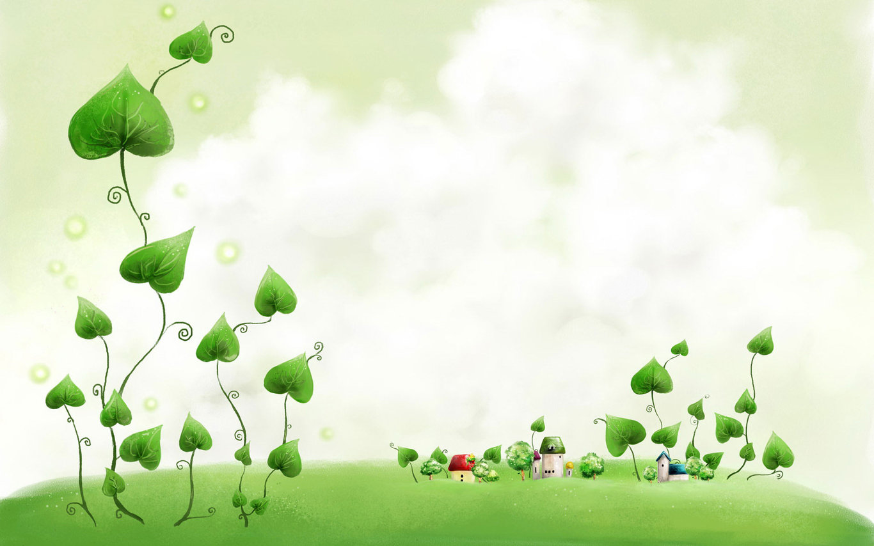


Monday, November 8th 2021
UNIT 3
COMMUNITY SERVICE
Period 23
LOOKING BACK + PROJECT
Notes:
1

Slide 2
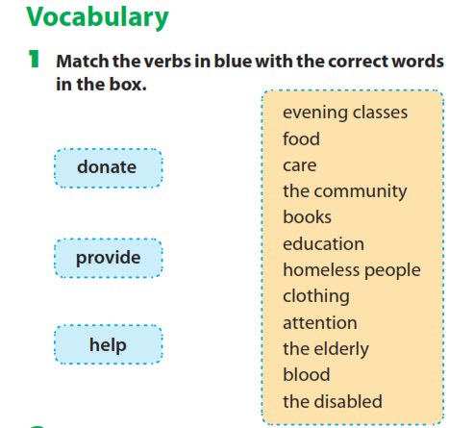

Slide 3
food
evening classes
care
the community
books
homeless people
clothing
attention
the elderly
blood
the disabled
donate
provide
help

Slide 4
Tenses:
II. Past simple tense.
Form:
+
S + V – ed/ cột 2
-
S + didn’t + V (inf)
?
Did+ S + V(inf) …?/ Wh question + did + S + V(inf)?
Use:
1, Diễn tả một hành động, sự việc đã xảy ra tại một thời điểm đã được xác định trong quá khứ và đã kết thúc hoàn toàn ở quá khứ.
Ex: My children came home late last night. (Các con của tôi về nhà muộn đêm qua.) → sự việc “các con về nhà muộn” đã diễn ra trong quá khứ và đã kết thúc trước thời điểm nói.
2. Diễn đạt các hành động xảy ra liên tiếp trong quá khứ.
Ex: Laura came home, took a nap, then had lunch. (Laura về nhà, ngủ một giấc, rồi ăn trưa.) → ba hành động “về nhà”, “ngủ” và “ăn trưa” xảy ra nối tiếp nhau trong quá khứ.
Adverbs: + Yesterday : ngày hôm qua,
+ Last night: tối hôm qua/ last week tuần trước/ last month: tháng trước / last year: năm ngoái/ last Sunday: chủ nhật trước
+ Ago: cách đây. Ex: two weeks ago: cách đây 2 tuần…)
+ When + m/đề chia thì quá khứ đơn: khi (when I was a kid,…)

Slide 5

Tenses:
Present perfect tense.
Form:
S + have/ has + past participle (Ved/ côt 3)….
+
-
S + haven’t/ hasn’t + past participle (Ved/ côt 3)….
?
Have/ Has + S + past participle (Ved/ côt 3)….
Use:
1. Diễn tả một hành động, sự việc đã xảy ra trong quá khứ nhưng vẫn còn tiếp diễn ở hiện tại
Ex: - Jane has stayed with her parents since she graduated.
Adverbs For + quãng thời gian: trong khoảng (for years, for a long time)
Since + mốc thời gian: từ khi (since 2001,…) so far: cho đến bây giờ
2. Diễn tả một kinh nghiệm cho đến thời điểm hiện tại
Ex: - Jane has never visited America
Adverbs: ever: đã từng ; never chưa bao giờ
3. Diễn tả một hành động đã xảy ra trong quá khứ, nhưng không nói rõ thời gian
Ex: - Jane has visited America before
Adverbs: before : trước đây, once: 1 lần, twice: 2 lần, three times. Several times: vài lần, many times: nhiều lần
Ex: - Jane has written three books and she is working on another one
4. Diễn tả một hành động vừa mới xảy ra
Ex: I have just met him
Adverbs: just: vừa mới, already: vừa xong, recently, lately

Slide 6
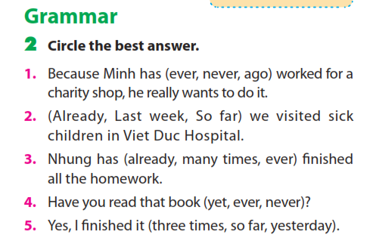

Slide 7
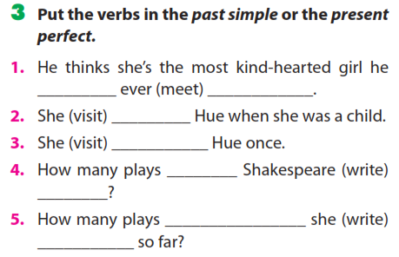
has
met
visited
has visited
did
write
has
written

Slide 8
Exercise 2: Put the verbs into the correct tense (simple past or present perfect simple).
1. A: I (cycle / just) ...............................50 km.
2. B: I (cycle) ...............100 km last week.
3. A: I (write) ................ an essay yesterday.
4. B: I (write / already) ................................... two essays this term.
5. A: I (ring / just)..................................my friend.
6. B: I (ring).....................my friend 10 minutes ago.
7. A: Two days ago, I (watch) .................a Madonna concert on TV.
8. B: I (see / already) ..................................Madonna live in concert.
9. A: I (spend) ........... my summer holiday in Australia last year.
10. B: I (be / not) ............................. to Australia yet.
have just cycled
cycled
wrote
have already written
have already rung
rang
watched
have already seen
spent
haven’t been

Slide 9
Exercise 5: Put these verbs into correct form.
1. I (walk)................to work everyday.
2. She (work) ....................in a bank two years ago.
3. We often (see)..............him on the way me last year.
4. Up to the present, John ………...good work in the class (do)
5. I (go) .............to town yesterday, and I (buy) ...................a new book.
6. John (leave) ..................... for France tomorrow.
7. He (leave).............. yesterday.
8. He (work).............................here since August.
10. I seldom (go) ..........to the cinema.
11. I (read) ......................that book already.
12. They just (come)................................
13. I (be) ............in the army during the Second World War.
14. The phone is ringing. – I ……………... it. (answer)
15. Where are you? - I’m upstairs. I (have) ………… …. a bath.
walk
worked
saw
is doing
went
bought
will leave
left
has worked
go
has read
have just come
was
will answer
am having

Slide 10
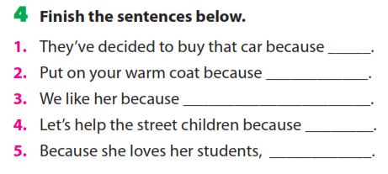

Slide 11
the engine is very good
it is going to be cold this evening
she’s kind
they are not as lucky as we are
she works very hard to improve her teaching

Slide 12
Rewrite the sentences using So and because
1. We stopped playing football . It rained heavily.
2. They had to hurry indoors It was raining.
3. We didn’t arrive until six o’clock. The traffic was terrible.
4. He found the exam easy . He had worked hard during the course.
5. She can’t drive. She has a headache
6. I failed in my exam . I didn’t study.
7. It’s raining. I’ll stay home and read.
8. Nam is tall, he can reach the picture on the wall.
9. I don't like her. She is mean and arrogant.
10. Her key was lost. Her children had dropped it on the road.
11. I like this picture. It's beautiful.
12. She could only eat a salad in the restaurant . She is a vegetarian.

Slide 13
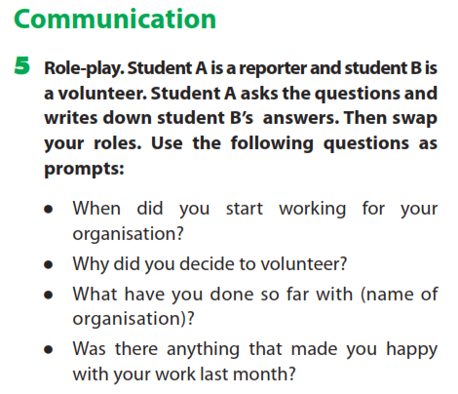

Slide 14
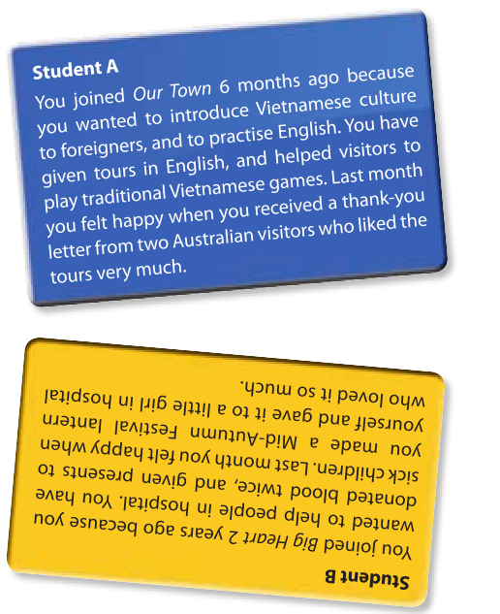

Slide 15

homework
Learn by heart the structure.
Do all exercises again
Prepare Unit4 Getting Started.

Slide 16




The bye bye song
Bye, bye.
See you tomorrow.
Bye, bye.
See you tomorrow.
Bye, bye.
See you tomorrow.
Bye, bye. Bye, bye.
The bye bye
song
Notes:
16

